Slide 1

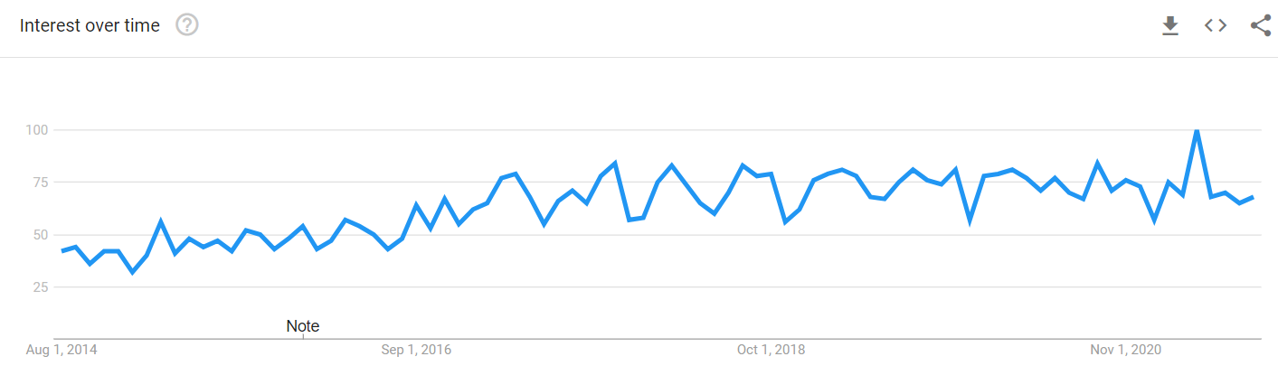
FRAUD DETECTION
Keivan Mokhtarpour
August 2021

Slide 2

PAYMENT FRAUD
Credit Card and Bank Loan Scams
Most common fraud type tackled by AI
Most common types of payment fraud:
Lost Cards
Stolen Cards
Card ID theft
Counterfeit Cards
Card Non-receipt

Slide 3

Old School Fraud Detection
False Positives
Using lots of rules tends to result in a high number of false positives
Fixed Outcomes
The thresholds for fraudy behaviour can change over time
Inefficient and Hard to Scale
Using a rules-only approach means that your library must keep expanding as fraud evolves.

Slide 4

ML Based Fraud Detection
Super Fast
When it comes to fraud decisions, you need results FAST!
Scalable
Every online business wants to increase its transaction volume.
Efficient
The human cost would be immense. The ML cost is just the cost of the servers running.
More Accurate
Machine learning models can learn from patterns of normal behavior.

Slide 5
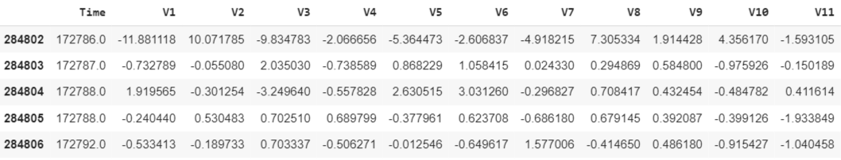
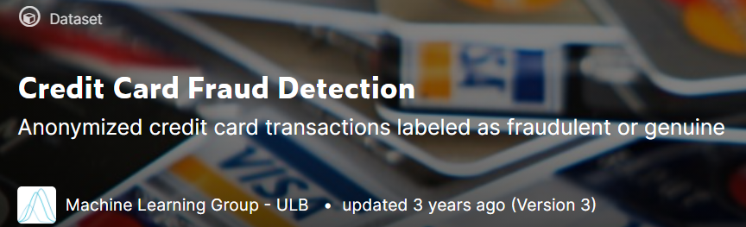
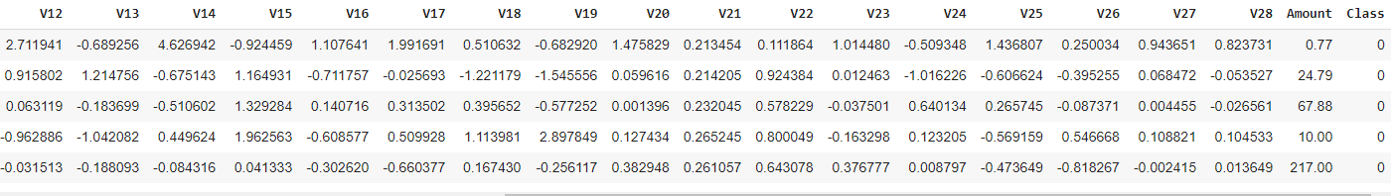
Credit Card Fraud Detection Dataset
https://www.kaggle.com/mlg-ulb/creditcardfraud
28 PCA transformed features
‘Time’ (Non-Relevant) and ‘Amount’ features are not transformed.
There are no missing values in the dataset.
Total Transactions: (284807)

Slide 6
OUTLINE
PROBLEM WORKFLOW
Exploratory Data Analysis
Data Preprocessing
Applying ML/DL classifiers on the real dataset
Applying models after (under-over) sampling methods
Final Remarks

Slide 7
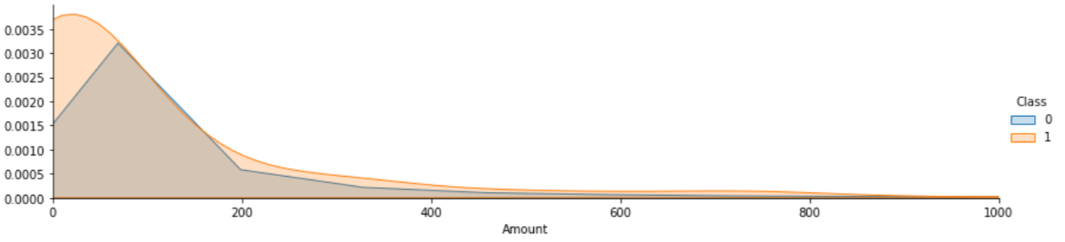
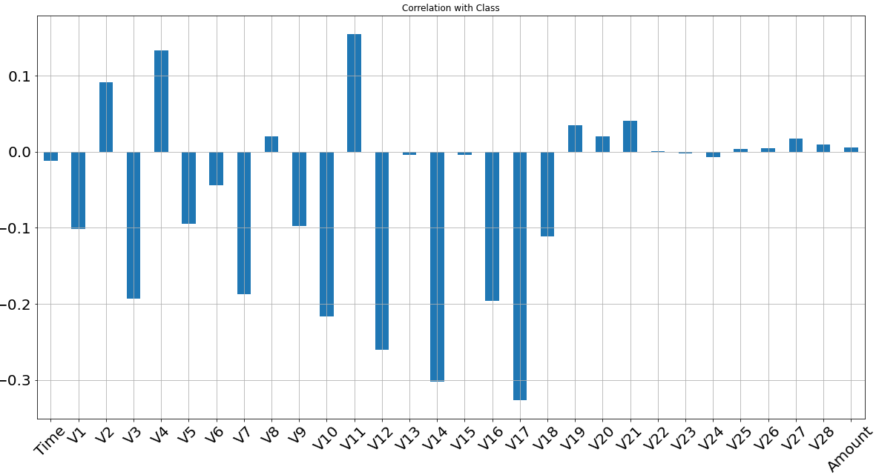
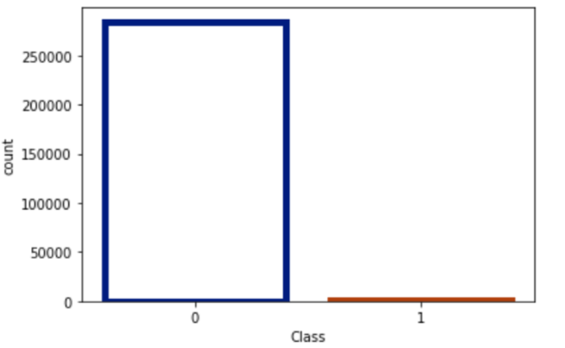
Exploratory Data Analysis (EDA)
Actual Distribution of Amount
Fraudulent Transactions: (492) 0.17 %
Normal Transactions: (284315) 99.83 %
Total Transactions: (284807)

Slide 8

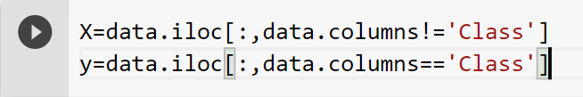
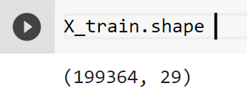
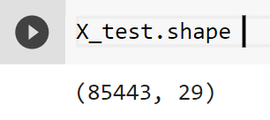
Data Preprocessing
Normalization: ‘Amount’
Dropping Features
Assigning independent and the target variables
Splitting the data into train and test sets
Train and Test Sets Shape (70% training set and 30% test set)

Slide 9
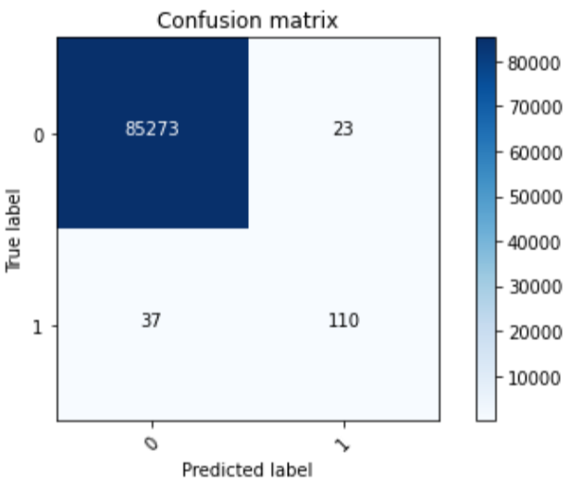
Model Performance
Decision Tree Classifier
Test Set Confusion Matrix
 | Recall | Precision | F1
Train Set | 1.0000 | 1.0000 | 1.0000
Test Set | 0.7482 | 0.8270 | 0.7857
Entire Dataset | 0.9247 | 0.9518 | 0.9381

Slide 10
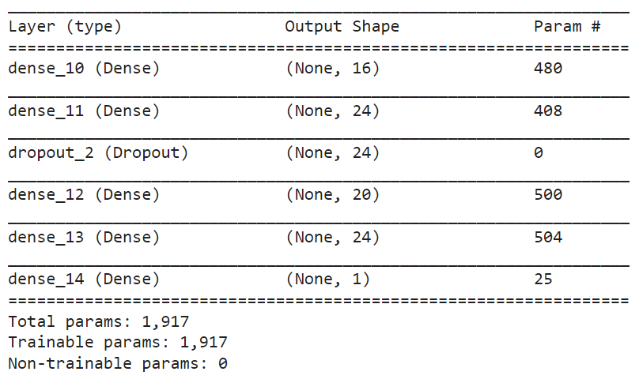
MODEL ARCHITECTURE
Keras Sequential API
ReLU is used to add non-linearity to the network.
Sigmoid is used to predict the probability as an output.
Dropout drops randomly a propotion of the network and forces the network to learn features in a distributed way.
Loss Function: Binary CrossEntropy
Optimization Algorithm: Adam

Slide 11
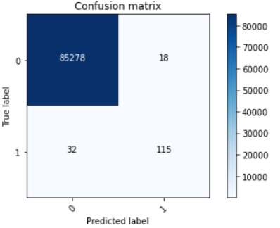
Model Performance
ANN
Test Set Confusion Matrix
 | Recall | Precision | F1
Train Set | 0.7681 | 0.8862 | 0.8229
Test Set | 0.7823 | 0.8646 | 0.8214
Entire Dataset | 0.7723 | 0.8796 | 0.8225

Slide 12
Imbalanced Dataset
Fraudulent Transactions: (492)
Normal Transactions: (284315)
Sampling Approaches:
Undersampling
Oversampling (SMOTE)

Slide 13
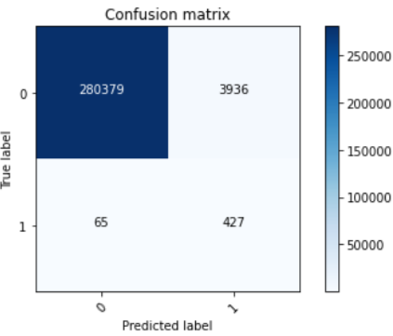
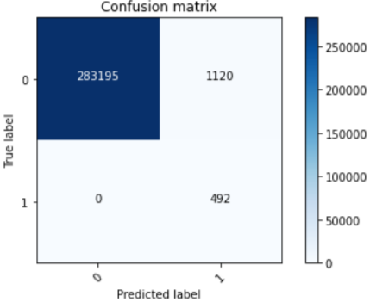
Model Performance
ANN
Original Entire Dataset Confusion Matrix
Undersampling | Recall | Precision | F1
Undersampled Train Set | 0.8724 | 1.0000 | 0.9318
Undersampled Test Set | 0.8571 | 1.0000 | 0.9230
Original Entire Dataset | 0.8678 | 0.0978 | 0.1759
Oversampling | Recall | Precision | F1
Oversampled Train Set | 0.9999 | 0.9961 | 0.9980
Oversampled Test Set | 0.9999 | 0.9958 | 0.9979
Original Entire Dataset | 1.0000 | 0.3052 | 0.4676

Slide 14
MODEL PERFORMANCE RESULTS OVERVIEW
Model | Recall | Precision | F1
Decision Tree | 0.9247 | 0.9518 | 0.9381
ANN | 0.7723 | 0.8796 | 0.8225
ANN Undersampling | 0.8678 | 0.0978 | 0.1759
ANN Oversampling | 1.0000 | 0.3052 | 0.4676

Slide 15

THANK YOU!
Keivan

